Slide 3
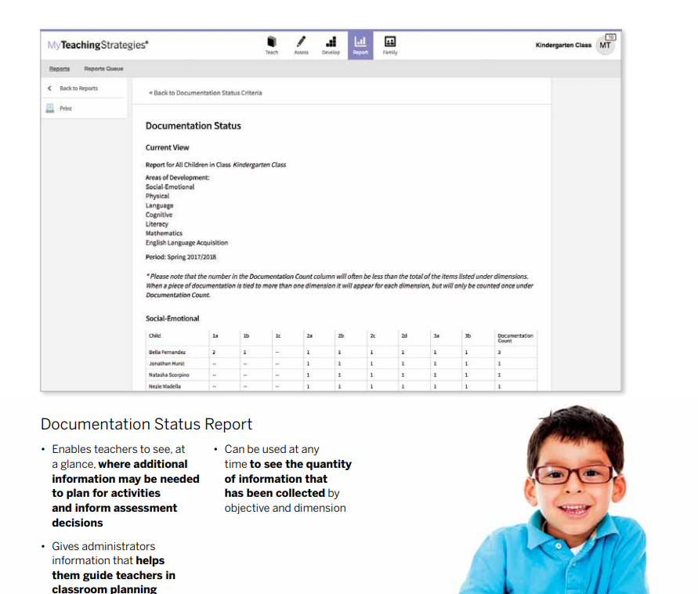
Which objectives might we need to focus on?

Slide 4
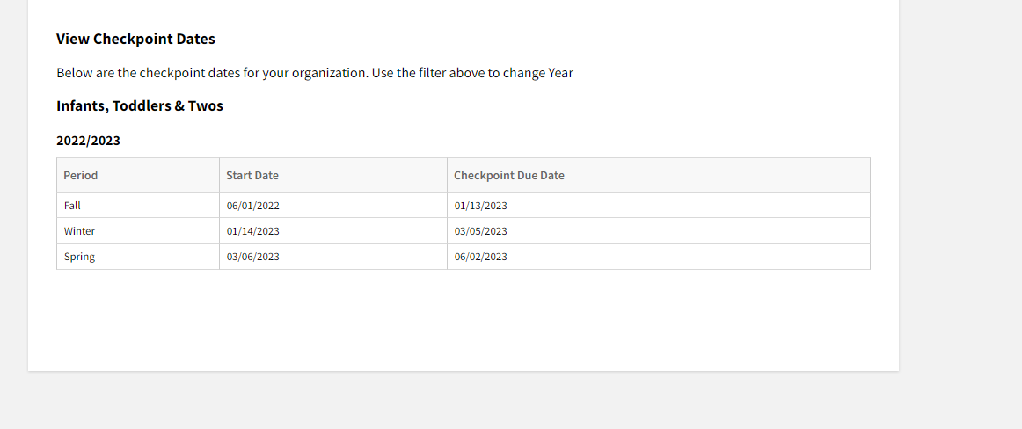
Checkpoint Dates

Slide 5
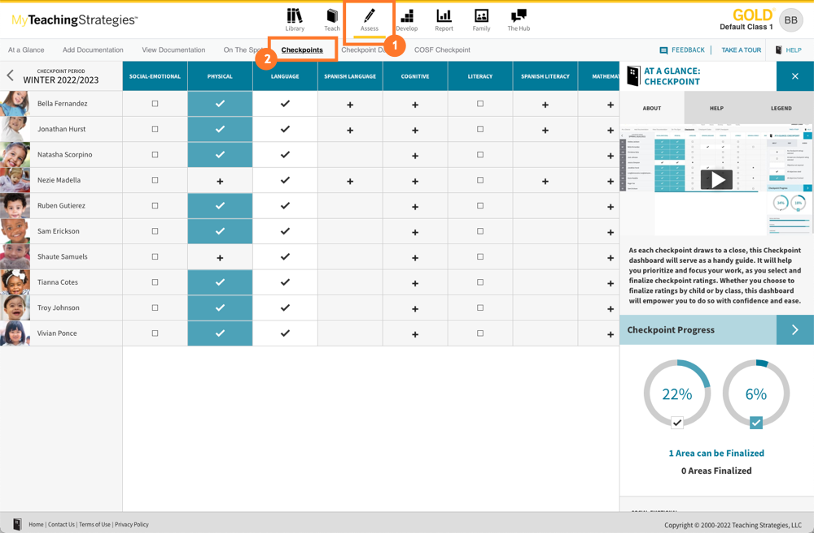
How to Locate the Checkpoints

Slide 6
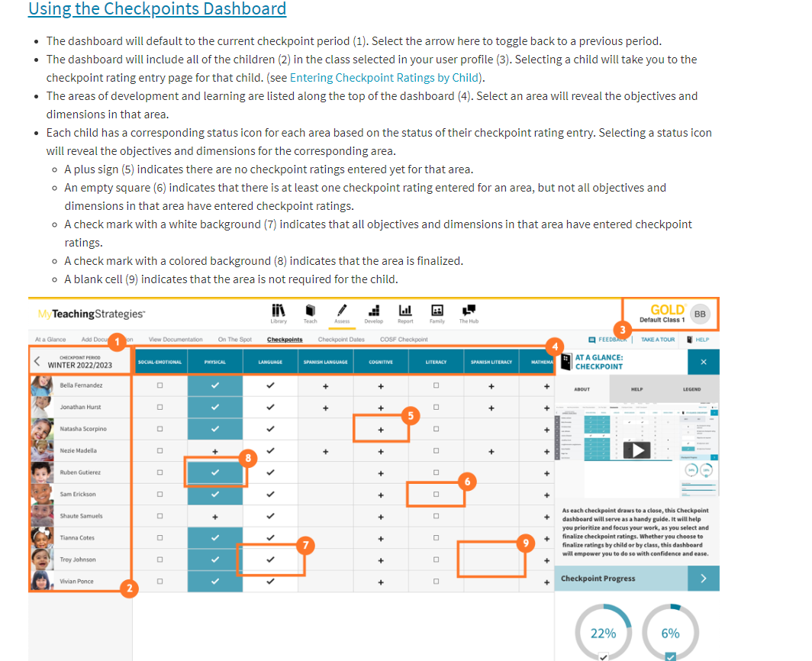

Slide 7
How to Complete Checkpoints
https://www.youtube.com/watch?v=GtqGISGWxp8

Slide 9
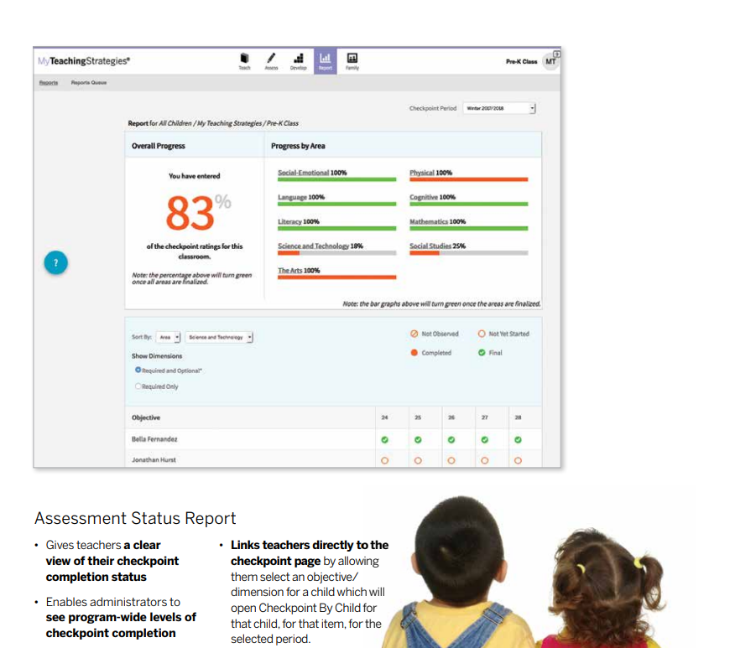

Slide 10
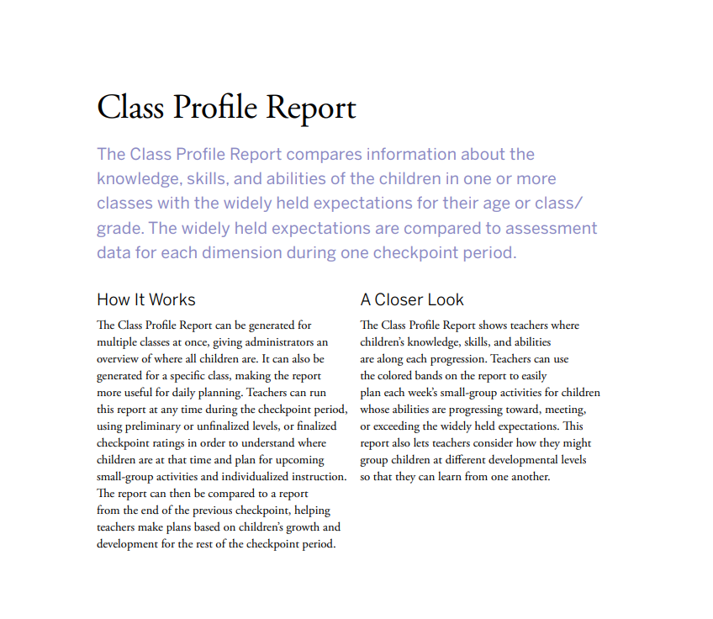

Slide 11
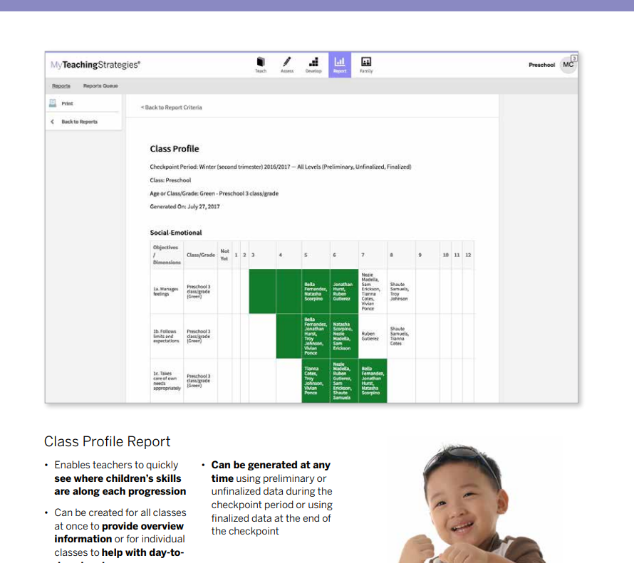

Slide 14
Resources
https://teachingstrategies.com/wp-content/uploads/2019/05/GOLD-Reports-Broch_2018.pdf – Reports Document

